Slide 1
Innovation for AAL

Slide 2



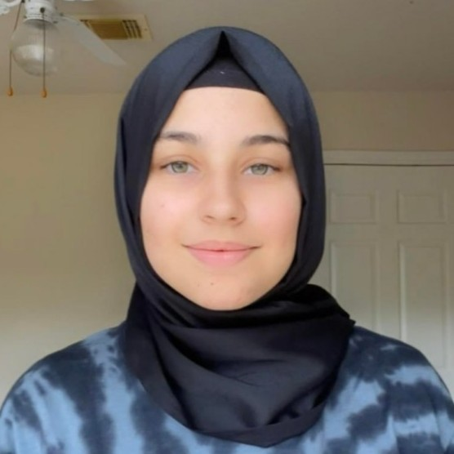
Meet our Team
Luis Alarcon CSCE 22’
Santana Gonzales
ITDE 23’
Juan Perez
ISEN 21’
Mualla Argin
CPSC 23’
Notes:
Hello, we are team #, and our names are: ….

Slide 3

Business Thesis
Our team will identify KPIs that the Army Applications Lab can use to evaluate the success of innovation projects
Notes:
Juan

Slide 4
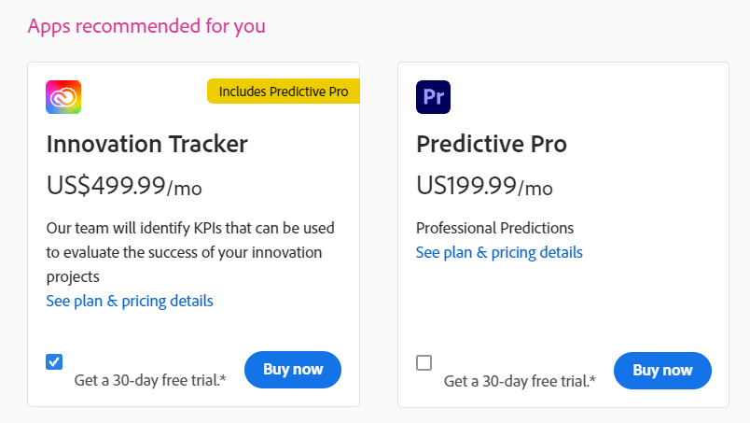

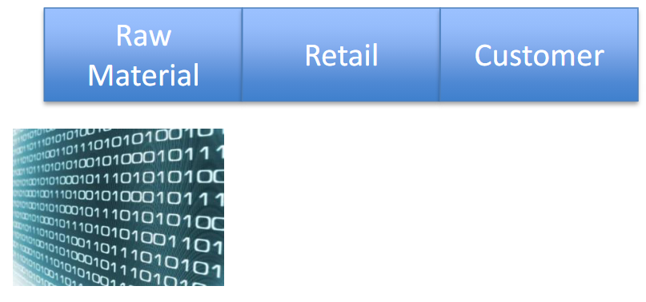
Value Chain
Notes:
Raw material -> code
Retail -> Our website
Customer -> AAl

Slide 5
Number of Customer Interviews
So far we have 6 customer interviews
Most Recently:
Andy Riise, Dr. Perley, and Kedar Pavgi
Planned Interviews:
Chris Curran, Jim Rabuck, and other faculty and industry experts
Notes:
Add number of customer interviews

Slide 6
Key Interviews
Dr. Casey Perley
Director of Technical Insights and Analysis at AAL
Work to get us more data
Give key feedback on where our project is going
Different R.O.Is
Kedar Pavgi
National Program Director at NSIN
Army Futures Command and CFTs
Proxy Metrics for projects in progress

Slide 7
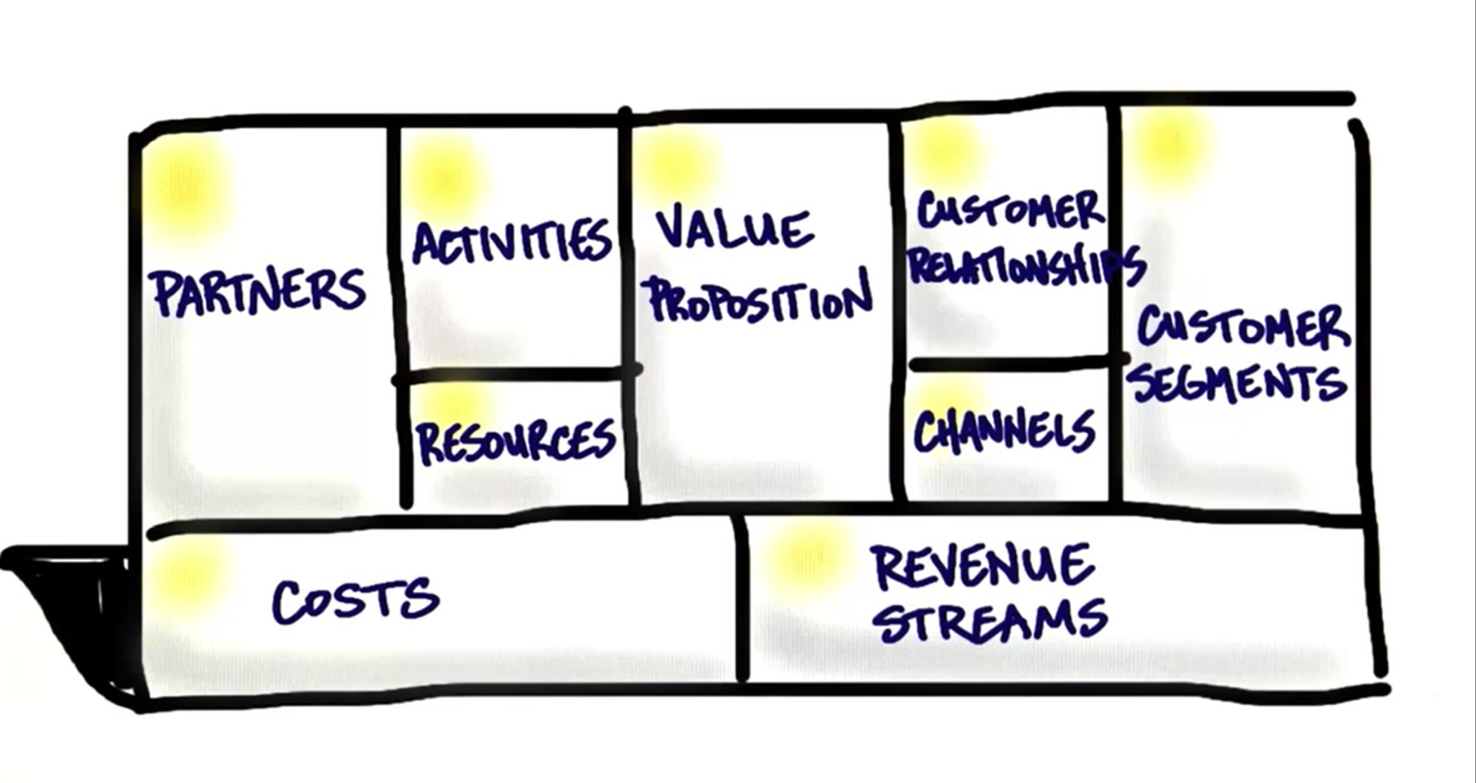
Mission Model Canvas

Slide 8
1. Value Proposition
We return the power of choice to our customers by measuring the innovative success of their investment mid project.

Slide 9

2. Customer Segments
Primary Example
Army Application Laboratory
Type
Business to Business
Description
Business that are invested in research and development projects that are interested in measuring the innovative success through KPIs

Slide 10
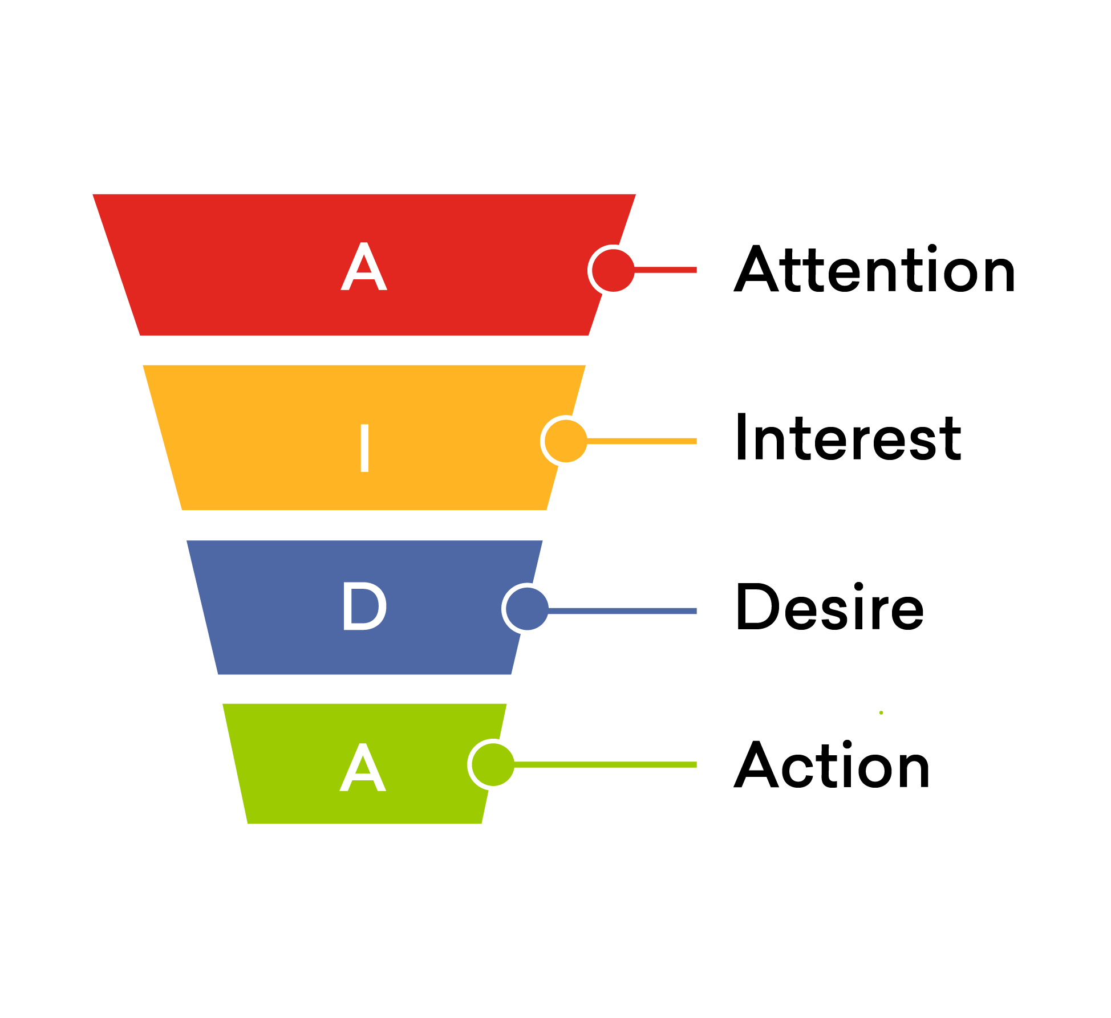
3. Channels
Physical Channels
Word of mouth
Tech Conferences
Online Channels
Email
Website

Slide 11
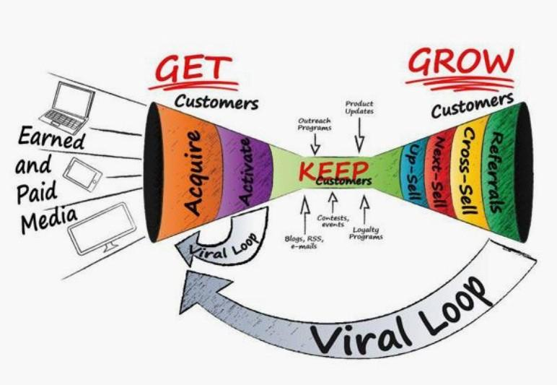
4. Customer Relationship
Get
Week trial
Keep
Constant updates
Grow
Referral programs

Slide 12
5. Revenue Streams
Subscription Based
Monthly
Yearly
Prices based on size of business
More data will require more service
Value
The ability to catch a project to fail is saving millions of dollars

Slide 13

6. Key Resources
Finance
Cloud Storage for Data
Intellectual
AAL dataset and case study
Human
Software Engineers
Notes:
Key Resources
What are the most important assets required to make the business model work?
Finance
Raising Money
Line of Credit
Physical
Manufacturing
Machines
Vehicles
Intellectual
Patents
People
Customer Lists
Human
Software Engineers

Slide 14

7. Key Partners
Army Applications Laboratory
U.S. Army Combined Arms Support Command
Long Range Precision Fires Cross Functional Team
Next Generation Combat Vehicles Cross Functional Team
and more..
Notes:
Key Partners
Who are the key partners and the suppliers needed to make the business model work?
What key resources are we acquiring from them?
What key activities do they perform
CASCOM - U.S. Army combined arms support command (trains army &civilians)
LRPF - Long Range Precision Fires
NETWORK - Ask Perley
NGCV - Next Generation Combat Vehicles
PNT - Positioning, Navigation and Timing. ... Navigation is the ability to determine current and desired position and apply corrections to course, orientation, and speed to attain a desired position anywhere around the world, from surface to surface and from surface to space.

Slide 15

8. Key Activities
Meet with Dr.Perley to go over dataset
Meet with Data Scientist/Statisticians to understand which models are best for this data
Get advice from fellow UI Designers and Software Developers
User Research
Notes:
Key Activities
What are the most important things the company must do to make the business model work?
Production
Supply Chain Management
Problem Solving
Consulting
Engineering

Slide 16
9. Cost Structure
Initial cost
Cost of hiring developers
Cost of hiring UI Designers
Maintenance
Hosting dashboard
Cost of cloud service
Notes:
Cost Structure
What are the costs to operate the business model ?
What are the most important costs
What are the most expensive resources

Slide 17
Questions?

Slide 18
References:
https://aal.army/
https://aal.army/what-we-do/
https://aal.army/our-team/
https://www.mckinsey.com/business-functions/strategy-and-corporate-finance/our-insights/how-to-take-the-measure-of-innovation

